Slide 1
SMART CITY’s SMART TRAVEL
Piyush Saxena

Slide 2
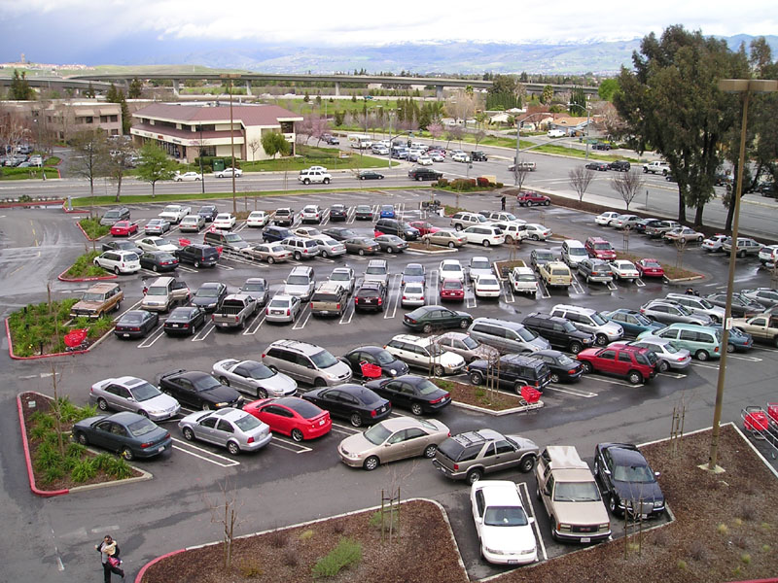
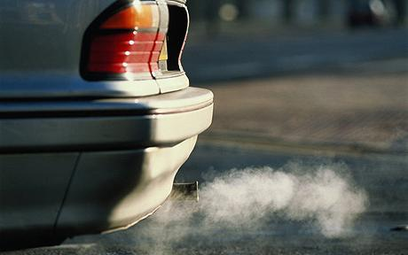
Background
Cities get clogged with the increasing number of cars.
Parking area is limited and sometimes not available for each employee in a commercial building.
An estimated 150 million—live in areas that don’t meet federal air quality standards.
In 2013, transportation contributed more than half of the carbon monoxide and nitrogen oxides, and almost a quarter of the hydrocarbons emitted into our air.

Slide 3
solution
Car Owner
Registers his car with the Enterprise and creates a profile for his car.
Travel Seeker
Registers with the Enterprise. Can view and unlock a car for his travel.
Car Pooler
A Travel Seeker can chose o car pool with other travel seekers.

Slide 4
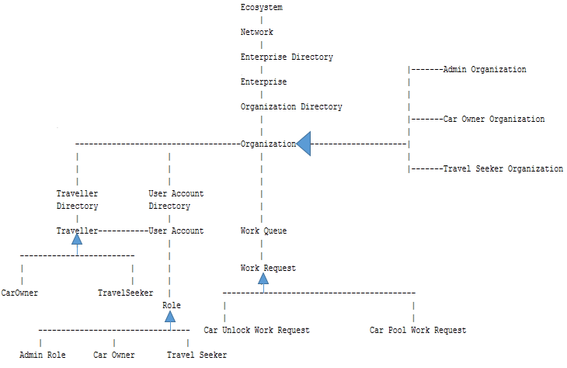
Object model

Slide 5
Salient Features
A Car Seeker can get the directions of his destination with information regarding direction, distance and minutes.
Car Owner can design a fare calculating method. All car seekers can see in a graph the fares quoted by the car owners for all the 8 hours the employee(car owner) is at work.
Until the capacity of the car is exhausted, car poolers can be added to the car.
Fare is calculated and divided amongst the travelers.
If the travel seeker is trying to go to a place from where the return journey will take longer than the time car owner has allowed his car for car pool, then error message is displayed.

